Slide 1


Chapter Seventeen
Unemployment Causes and Consequences
Prepared by Dr. Mir Ahasan Kabir
York University

Slide 2
Learning Objectives
Explain how imperfect information can lead to a labour market equilibrium in which unemployed workers and unfilled job vacancies co-exist.
Discuss and assess evidence on how technological change, especially the growing use of the Internet, is affecting job search and the matching of unemployed workers and unfilled job vacancies.
Explain how shifts in the structure of product demand can be a source of unemployment in the labour market.
Summarize empirical findings on job displacement and its consequences.
© 2021 MCGRAW-HILL EDUCATION LTD.
17 - <number>

Slide 3
Learning Objectives
Describe leading models of worker and employer behaviour that give rise to employers paying above-market wages, thus, resulting in a labour market equilibrium with unemployed workers.
Explain the rationale for publicly provided unemployment insurance, and the ways that unemployment insurance may influence labour supply and unemployment.
Summarize the empirical evidence on the relationship between unemployment insurance and labour supply and unemployment.
© 2021 MCGRAW-HILL EDUCATION LTD.
17 - <number>

Slide 4
Main Questions
What role does wage rigidity play in explaining unemployment? What alternative theories to the conventional neoclassical model can help explain why wages may not adjust, even in the face of considerable unemployment?
How does imperfect information manifest itself in the labour market? In what ways might imperfect information be an important cause of unemployment? What are the appropriate (or inappropriate) government responses to this feature of the labour market?
How are improvements in information technology affecting the way that workers search for jobs and employers search and screen for qualified workers? Is online search and matching improving the efficiency of the labour market?
© 2021 MCGRAW-HILL EDUCATION LTD.
17 - <number>

Slide 5
Main Questions
What role does wage rigidity play in explaining unemployment? What alternative theories to the conventional neoclassical model can help explain why wages may not adjust, even in the face of considerable unemployment?
How does imperfect information manifest itself in the labour market? In what ways might imperfect information be an important cause of unemployment? What are the appropriate (or inappropriate) government responses to this feature of the labour market?
How are improvements in information technology affecting the way that workers search for jobs and employers search and screen for qualified workers? Is online search and matching improving the efficiency of the labour market?
What are the consequences of job loss for workers and their families? Do some displaced workers suffer more than others from involuntary job loss?
What role does unemployment insurance play in affecting the structure of unemployment in Canada? Does it do more harm than good?
© 2021 MCGRAW-HILL EDUCATION LTD.
17 - <number>

Slide 6
Causes of Unemployment
The minimum wage laws
Institutional factors such as unions or large public sector
Demand factors
Seasonal unemployment
Frictional unemployment associated with normal turnover of the work force
Sectoral shifts causing structural unemployment: Time lag in finding a job
High unemployment insurance
© 2021 MCGRAW-HILL EDUCATION LTD.
17 - <number>

Slide 7
Frictional or Structural Unemployment
Search Unemployment:
Job search associated with imperfect information causes delays
Job search involves costs and benefits
Expected benefits have to be weighted against the expected costs
The condition of optimal search is a stopping rule: a minimum acceptable requirements (wage, benefits, working conditions, etc.) is chosen and the search is executed until the job that meets the acceptable requirements is found
More specifically…
© 2021 MCGRAW-HILL EDUCATION LTD.
17 - <number>

Slide 8
Frictional or Structural Unemployment
Employees continue to search until expected marginal benefit equal expected marginal cost
Benefits and costs of search are likely to be related to the amount of time devoted to a job search
Marginal cost is rising with the amount of job search undertaken
Optimal amount of a search will maximize the difference between B and C (see the diagram on the next page)
The difference is maximized when expected marginal benefit equals expected marginal cost at S_{e} (see the diagram on the next page)
© 2021 MCGRAW-HILL EDUCATION LTD.
17 - <number>

Slide 9
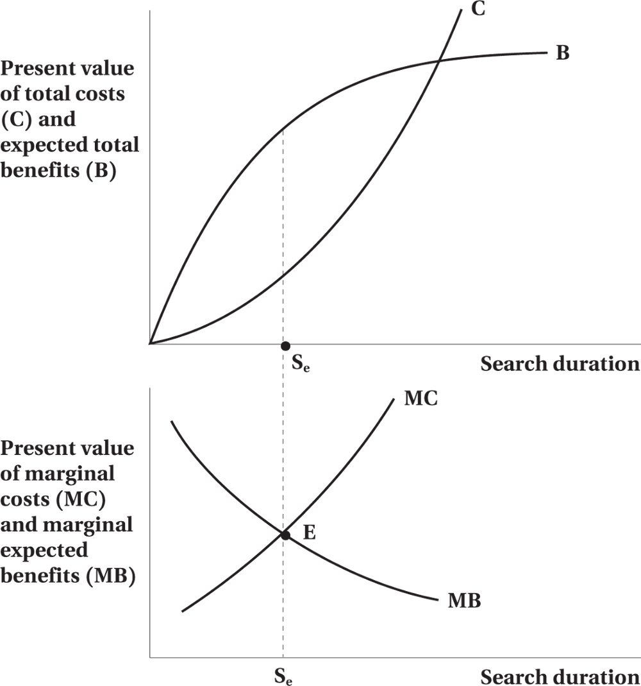
Frictional or Structural Unemployment
Figure 17.1 Optimal Job Search
© 2021 MCGRAW-HILL EDUCATION LTD.
17 - <number>

Slide 10
Frictional or Structural Unemployment
Implications of imperfect information
Generally workers and firms will stop their search activities prior to being fully informed due to diminishing returns to information acquisition and also increasing costs of information acquisition. As a result:
  A labour market characterized by imperfect information will not clear instantaneously
  Dispersion of wage rates will occur even in a labour market with homogeneous workers and jobs
  Case of dynamic monopsony
© 2021 MCGRAW-HILL EDUCATION LTD.
17 - <number>

Slide 11
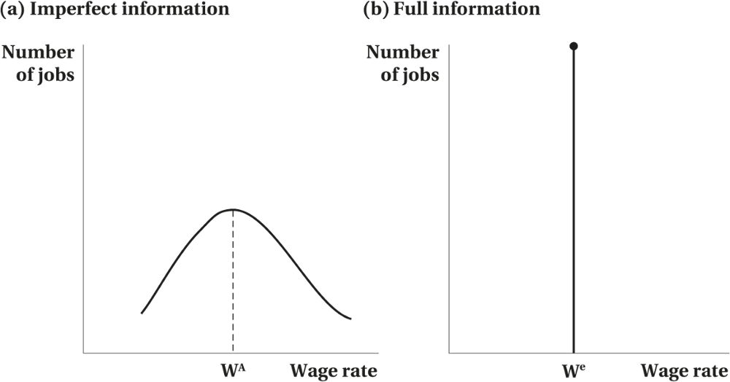
Frictional or Structural Unemployment
Figure 17.2 Wage Distributions Under Imperfect and Perfect Information
© 2021 MCGRAW-HILL EDUCATION LTD.
17 - <number>

Slide 12
Frictional or Structural Unemployment
Worked Example
Job Search and the Reservation Wage
Julia just graduated from college and is looking for a first job.
There are three types of jobs:
  The best jobs pay $2400 a month.
  “Not as good” jobs pay $2200 a month.
  The worst type of job pays $2000 a month.
  The probability of each type of job offered is one-third.
© 2021 MCGRAW-HILL EDUCATION LTD.
17 - <number>

Slide 13
Frictional or Structural Unemployment
Julia must now decide what to do once she gets an offer
  The expected value of a future offer is $2200 a month (average of $2000, $2200, and $2400 a month).
  She won’t accept a job offer unless it pays at least $2200 a month.
  2/3 is the hazard rate.
© 2021 MCGRAW-HILL EDUCATION LTD.
17 - <number>

Slide 14
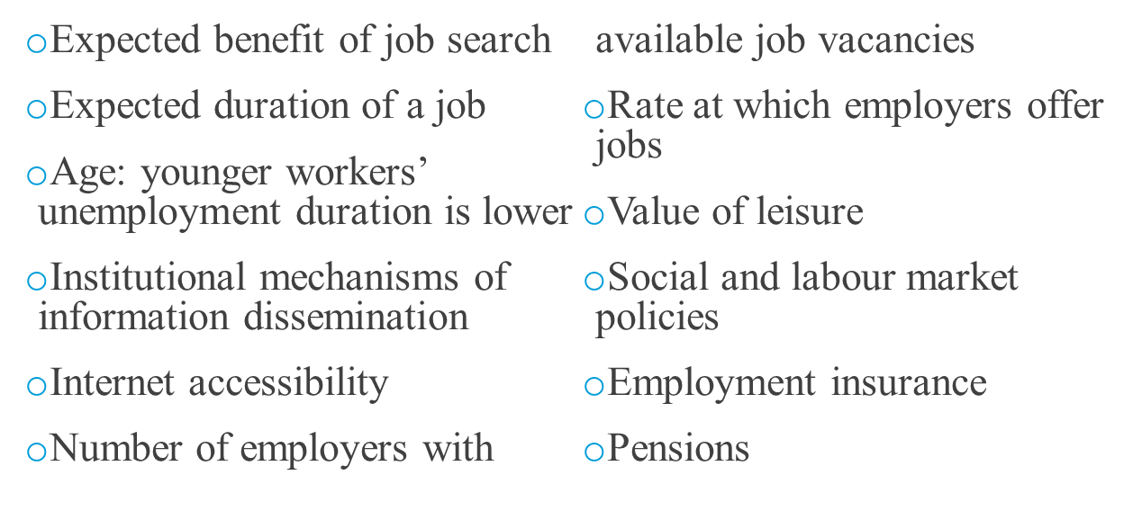
Frictional or Structural Unemployment
Factors Determining Optimal Search
© 2021 MCGRAW-HILL EDUCATION LTD.
17 - <number>

Slide 15
Empirical Evidence on Job Search
Table 17.1 Search Activity of the Unemployed, 2019
Group and Search Activity |  | Number Using Activity (thousands) | Percent Using Activity ^{(%)}
Unemployed: | Did not search | 101 | 8.8
Unemployed: | Searched for full-time work | 747 | 65.3
Unemployed: | Searched for part-time work | 295 | 25.8
Search activity: | Looked at advertisements | 684 | 59.8
 | Contacted employers directly | 441 | 38.6
 | Placed or answered advertisements | 402 | 35.2
 | Checked with friends or relatives | 265 | 23.2
 | Used public employment agency | 134 | 11.7
 | Used private employment agency | 84 | 7.4
© 2021 MCGRAW-HILL EDUCATION LTD.
17 - <number>

Slide 16
Empirical Evidence on Job Search
Use of the Internet by workers to scout for jobs and by employers to find and select applicants has increased at a rapid rate
Extensive empirical research on estimating formal models of search behaviour
The dramatic growth in the use of online methods to advertise and search for jobs has also attracted research interest.
Technological advances is likely to improve the search and matching process.
© 2021 MCGRAW-HILL EDUCATION LTD.
17 - <number>

Slide 17
Sectoral Shifts and Unemployment
Unemployment would increase in periods of major structural adjustment
High employment growth across industries is associated with periods of high unemployment
Some industries are more cyclically sensitive than others
Economic shocks have more severe consequences for unemployment
Economic dislocation causes displacement of older and less educated workers
Unemployed workers relocate due to regional sectoral shifts in Canada
© 2021 MCGRAW-HILL EDUCATION LTD.
17 - <number>

Slide 18
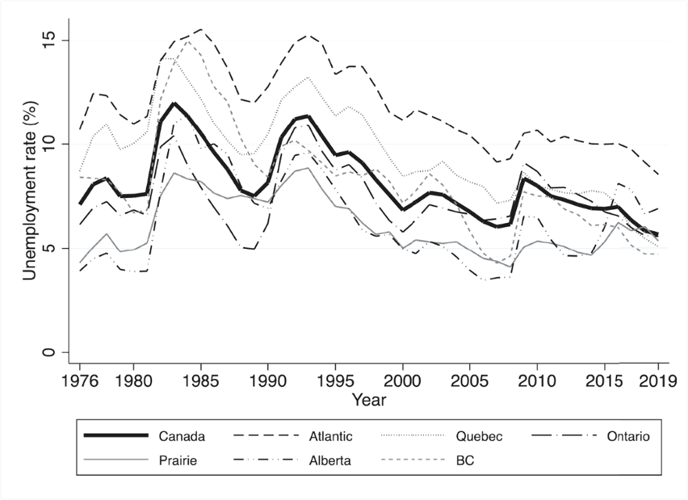
Sectoral Shifts and Unemployment
Figure 17.3 Regional unemployment rates, 1976-2019
© 2021 MCGRAW-HILL EDUCATION LTD.
17 - <number>

Slide 19
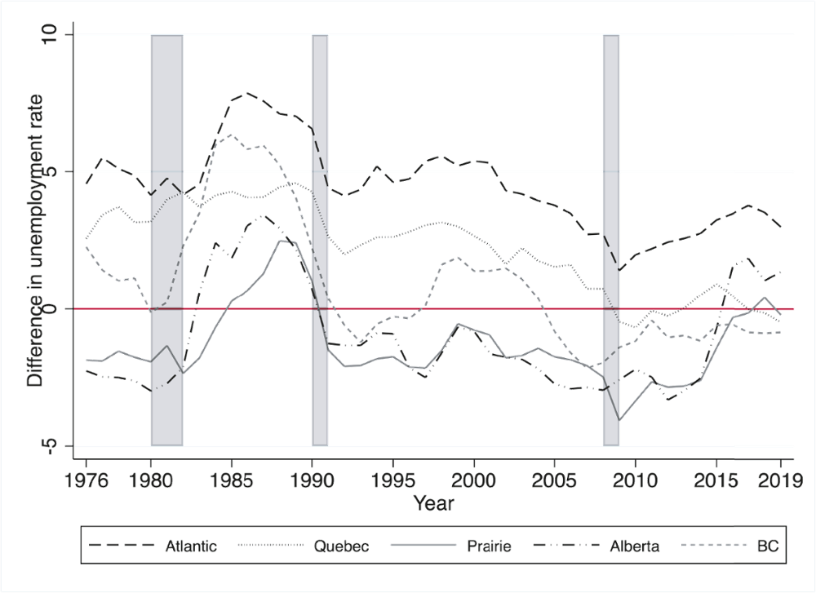
Sectoral Shifts and Unemployment
Figure 17.3 Regional unemployment rates, 1976-2019
© 2021 MCGRAW-HILL EDUCATION LTD.
17 - <number>

Slide 20
Displaced Workers and Unemployment
Earnings losses from permanent job loss are very large for workers with prior stable labour force attachment.
A major part of the earnings loss arises from re-employment at wages substantially below their pre-displacement levels.
These substantial losses appear to be long lasting.
Older displaced workers are less likely to become re-employed than their younger counterparts.
© 2021 MCGRAW-HILL EDUCATION LTD.
17 - <number>

Slide 21
High-Wage Unemployment
Alternative approaches
  Implicit Contracts
  Efficiency Wages
  Insider-Outsider Theories
© 2021 MCGRAW-HILL EDUCATION LTD.
17 - <number>

Slide 22
High-Wage Unemployment
Implicit Contract
Deals with issues that arise when firms and workers are engaged in a continuing employment relationship
Seeks to explain phenomena such as rigid wages and the use of quantity adjustments
Based on the view that employment behaviour reflects risk-sharing between employers and employees
Difference in attitudes toward risk between employers and employees provide the basis for both parties to benefit from a risk sharing arrangement
© 2021 MCGRAW-HILL EDUCATION LTD.
17 - <number>

Slide 23
High-Wage Unemployment
Reasons for workers being more risk-averse than employers:
  The main workers assets—human capital—not diversifiable (to reduce risk)
  Sorting according to innate risk preferences
        Entrepreneurs are mostly risk-neutral and risk-lovers
        Employees (wage earners) are mostly risk-averse
© 2021 MCGRAW-HILL EDUCATION LTD.
17 - <number>

Slide 24
High-Wage Unemployment
Other related issues:
Moral Hazard
  Individuals can influence the risk against which they are insured
Adverse Selection
  Insurer cannot observe the risk that a particular insuree presents
© 2021 MCGRAW-HILL EDUCATION LTD.
17 - <number>

Slide 25
High-Wage Unemployment
The Central Hypothesis of Implicit Contract Theory
The firms provide insurance only to its own employees, thus avoiding adverse selection problem
The firm controls the probability of income loss due to layoff or wage/hour reduction, thus avoiding the moral hazard problem
Implicit contract theory applies to situations in which there is a long-term attachment between the firm and its workers
Symmetric vs. asymmetric information
© 2021 MCGRAW-HILL EDUCATION LTD.
17 - <number>

Slide 26
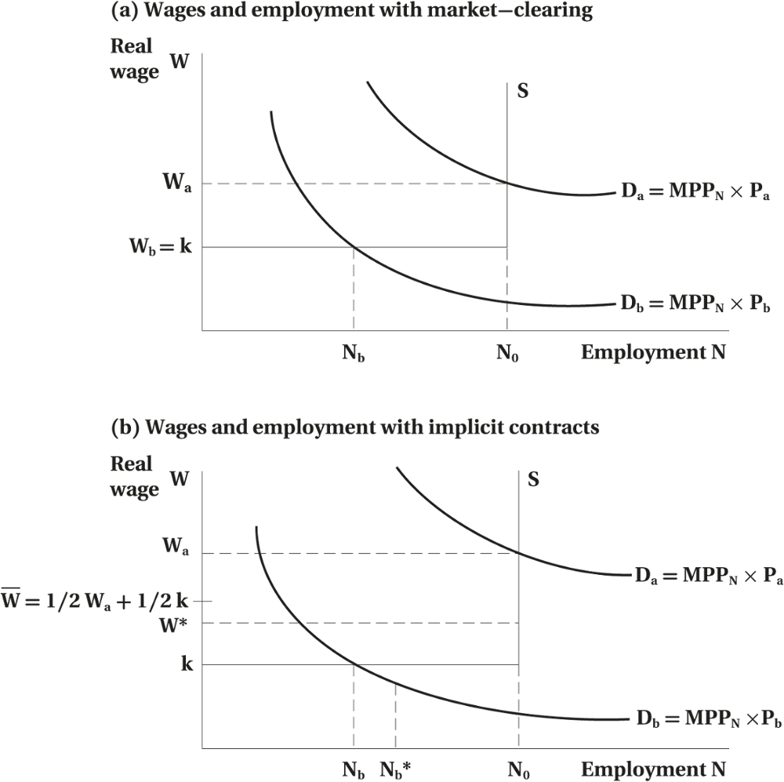
High-Wage Unemployment
Figure 17.4 Implicit Contracts
© 2021 MCGRAW-HILL EDUCATION LTD.
17 - <number>

Slide 27
High-Wage Unemployment
Wage and Employment with Market-Clearing
Base case without implicit contracts
N₀ workers attached to the firm and the value of leisure is k
Supply is perfectly elastic
In the good state N₀ workers are employed, earning W_{a}
In the bad state, N_{b} workers are employed, earning W_{b}
Earning variability is reduced with implicit contracts
© 2021 MCGRAW-HILL EDUCATION LTD.
17 - <number>

Slide 28
High-Wage Unemployment
Wages and Employment with Implicit Contracts
In the good state, employment will be at N₀ at a wage of W*
In the bad state, employment will be higher at N_{b}* and wages at W*
For workers it represents reduction in the risk
Firms are paying lower wages
Firms and workers are better off with risk-sharing
© 2021 MCGRAW-HILL EDUCATION LTD.
17 - <number>

Slide 29
High-Wage Unemployment
Main Features of Optimal Contract
Contract provides a rigid wage, independent of the state that is realized
Layoffs may occur in weak states of demand
The contract wage W* is lower than the market clearing wage in the good state
Both parties benefit from a risk sharing arrangement
Optimal contact reduces income uncertainty
The contract represents tradeoff between risk sharing and production efficiency
© 2021 MCGRAW-HILL EDUCATION LTD.
17 - <number>

Slide 30
Efficiency Wages
Firms choosing to pay wages above market clearing level
Enhance worker productivity
Improve worker morale
Discourage shrinking and absenteeism
Reduce turnover
Discourage unionization
Workers who eat better work harder
© 2021 MCGRAW-HILL EDUCATION LTD.
17 - <number>

Slide 31
Efficiency Wages
Nutritional Efficiency Wage Model
Output of rice is given by Q = F(eL)
Efficiency, e, depends on wage paid e =e(W)
Firm’s profit is given by
  Π = (F(eL) x L) – WL = g(W; L) – WL
If the firm reduces labour costs by paying a lower wage, these labour savings may be offset by a drop in labour productivity, so that the lower wage actually reduces profits.
© 2021 MCGRAW-HILL EDUCATION LTD.
17 - <number>

Slide 32
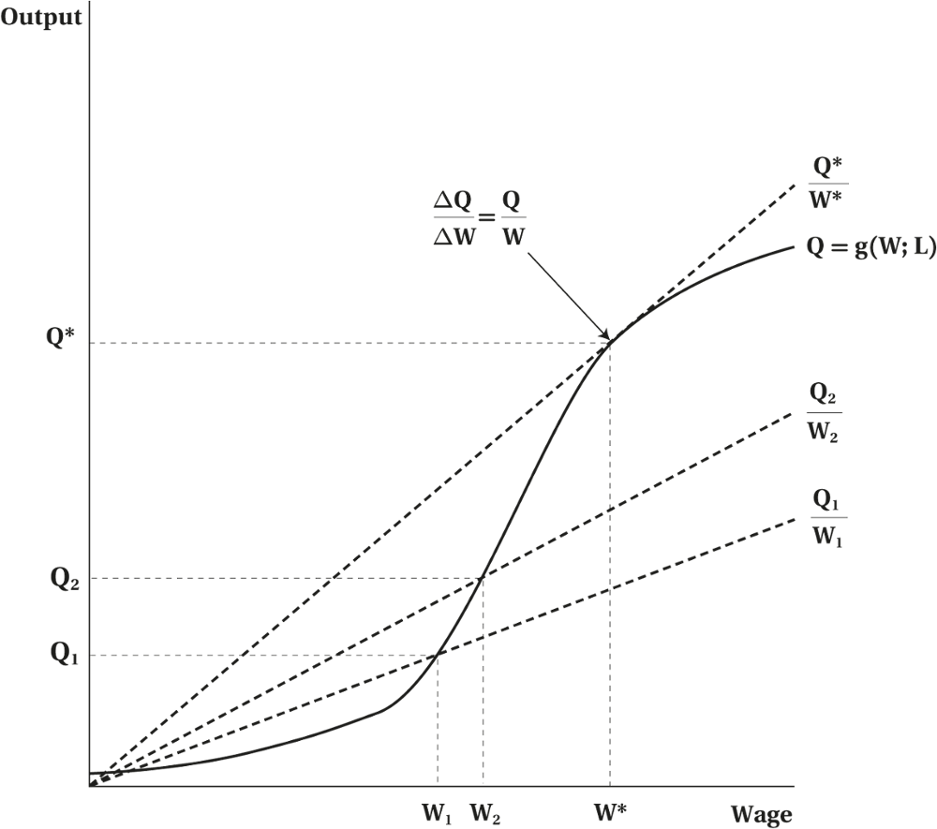
Efficiency Wages
Figure 17.5 Determination of the Efficiency Wage
© 2021 MCGRAW-HILL EDUCATION LTD.
17 - <number>

Slide 33
Efficiency Wages
Efficiency Wage Determination
Productivity increases only slowly at first when wage is increasing
Only when workers reach a certain threshold, we see an increase in efficiency
Diminishing returns take over
Higher wages beyond some point will have a small impact on productivity
Firm maximizing profits (minimizing costs) at Q/W
Optimum occurs at W* at the tangency where profits are maximized
© 2021 MCGRAW-HILL EDUCATION LTD.
17 - <number>

Slide 34
Efficiency Wages
Insider-Outsider Theory
Another explanation of wage inflexibility and unemployment
Persistent unemployment typically focuses on the wage determination process—wages may not adjust quickly to eliminate excess supply of labour
Wage setting is determined by bargaining between the employer and its existing work force (the “insider”)
The unemployed (the “outsider”) has little influence on the outcome
It’s costly to the firm to replace some of the existing workers
Increased bargaining power of the “insider” to raise wages, given the excess supply of labour, the “outsider”
© 2021 MCGRAW-HILL EDUCATION LTD.
17 - <number>

Slide 35
Unemployment Insurance and Unemployment
Economic Rationale for UI:
UI: provide workers with protection against the risk of income loss due to unemployment
Affects the incidence and duration of unemployment by altering the incentives facing workers and firms
© 2021 MCGRAW-HILL EDUCATION LTD.
17 - <number>

Slide 36
Unemployment Insurance and Unemployment
The effect of unemployment insurance on the incidence and duration of unemployment:
UI affects the incidence and duration of search by altering the costs and benefits of the job search
For the employed, the increase in benefit rate makes the job search more attractive, hence increasing the incidence of unemployment
For the unemployed, more generous UI lowers the costs of a job search, increasing the duration of job search and, hence increasing the unemployment rate
© 2021 MCGRAW-HILL EDUCATION LTD.
17 - <number>

Slide 37
Unemployment Insurance and Unemployment
The effect of unemployment insurance on the incidence and duration of unemployment:
More generous UI decreases the weeks worked
Higher benefits could also alter the behaviour of those who are not eligible for UI by accepting jobs quickly in order to qualify for subsequent UI benefits
The impact on the labour force participation
Repeated users
Regional extended benefits
© 2021 MCGRAW-HILL EDUCATION LTD.
17 - <number>

Slide 38
Unemployment Insurance and Unemployment
Canada’s Unemployment Insurance System
Canada’s UI system was established in 1940
Dramatic changes to these key features of the UI act were made in 1971–1972.
In 1996, the Unemployment Insurance program was renamed Employment Insurance (EI), and several key parameters were changed. And further refinement was made in 2000.
© 2021 MCGRAW-HILL EDUCATION LTD.
17 - <number>

Slide 39
Unemployment Insurance and Unemployment
Canada’s Unemployment Insurance System
Some features of the current EI program
  55 percent replacement rate for all beneficiaries
  Individuals working 15 or 50 hours per week accumulated the same credit toward UI eligibility
  The EI program currently distinguishes among three types of claimants:
    Frequent claimants
    Long-tenured workers
    Occasional claimants (all others).
© 2021 MCGRAW-HILL EDUCATION LTD.
17 - <number>

Slide 40
Unemployment Insurance and Unemployment
The Effect of Unemployment Insurance on the Incidence and Duration of Unemployment
For the unemployed who are eligible for benefits , UI has both a moral hazard effect and a liquidity constraint effect.
UI benefits lengthen unemployment spells.
UI benefits and durations may depend on prior work experience.
When UI benefits are exhausted, there is often a “spike” in the probability of leaving unemployment.
UI affects job search behaviour.
© 2021 MCGRAW-HILL EDUCATION LTD.
17 - <number>

Slide 41
Unemployment Insurance and Unemployment
The Effect of Unemployment Insurance on Labour Supply
Income-Leisure Model Predictions
Empirical research evidences
    A more generous EI benefit structure is to increase unemployment.
        Kuhn and Riddell (2010)
        Repeat use of UI
        The regional extended benefit structure
        The 1996 changes of UI program
Optimal EI design must strike a balance between these social costs and benefits.
© 2021 MCGRAW-HILL EDUCATION LTD.
17 - <number>

Slide 42
Chapter Summary
Causes and consequences of unemployment
Optimal search and the factors
Sectoral shifts, unemployment, and institutional rigidities
Displaced workers
Implicit contracts and their features
Efficiency wages and influences
UI rationale and its effects on unemployment
The effect of unemployment insurance on labour supply
© 2021 MCGRAW-HILL EDUCATION LTD.
17 - <number>

